Slide 1

Research Methodology Workshop
Session 2: Effective Literature Review
Ashish Anand & Vijaya Saradhi
Department of Computer Science and Engineering
IIT Guwahati

Slide 2
Effective Literature Review
Objective of literature search
Advantages of literature search
What to look for
Identifying and deciding alternate ways for search

Slide 3
Effective Literature Review
Where to look for
Organization and keeping track of important literature
Am I Done?
  Time-line: Too-long vs Too-short
  Is it ongoing and continuos process?

Slide 4
Where to look for?
What should be my strategy?

Slide 5
Strategy for search
Exploratory
Refining
Focused
Assessing the important and relevant articles

Slide 6
Where to look for
Google or other usual search engines
How about specialized and domain-dependent search engines
  Google-scholar
  Web-of-knowledge, scirus
  Citeseer, DBLP
  Digital Libraries, like ACM-digital, IEEE-Explore
  Journal and conference web-sites

Slide 7
Lets start with Google-scholar
Objective:
  Start with few keywords
  Find important and relevant articles (based on citation history, year published etc)
  Refine your keywords
  Identify key journals, conferences and research groups

Slide 8
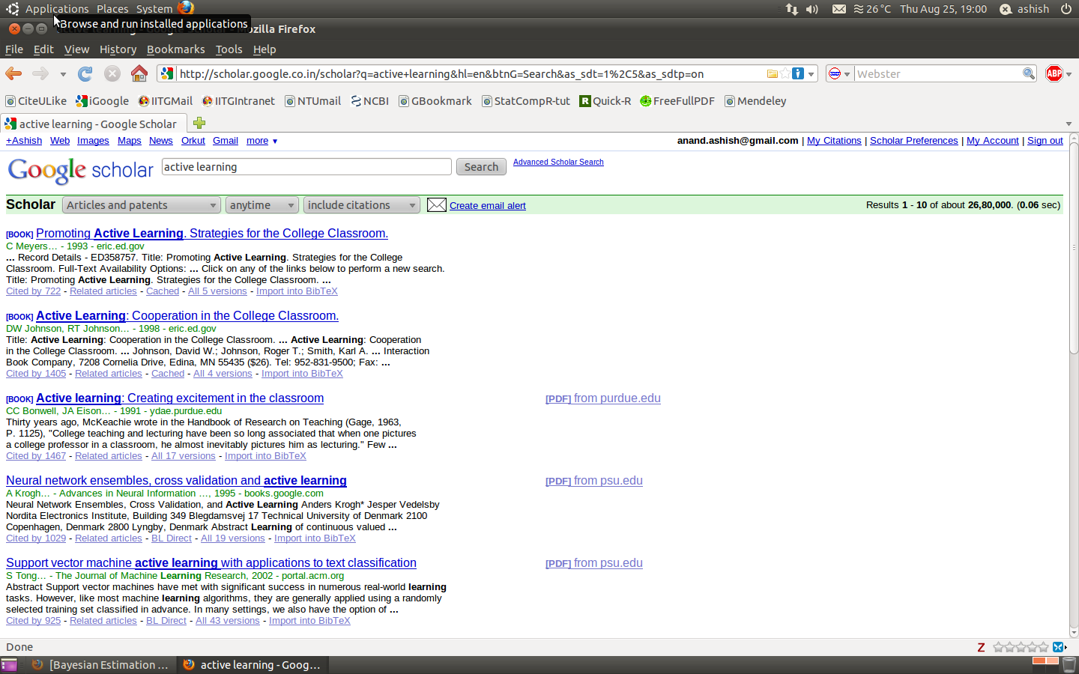
Continuing with Google-Scholar

Slide 9
What I observe ?
Many articles look out-of-place compared to my intented meaning
However, some of them do look what I actually meant
What else I see ?
  Related articles
  Cited by

Slide 10
What I still able to do ?
Refine my keywords
Get hold of some key papers
Where they got published
Basically, more pointers

Slide 11
Could I have done even better than this ?
OR
Can I further refine or be more focused ?

Slide 12
Dedicated literature databases
Ever checked E-resources provided at our central library ?
Several of them are focused and some of them are generic but perhaps better than google-scholar

Slide 13
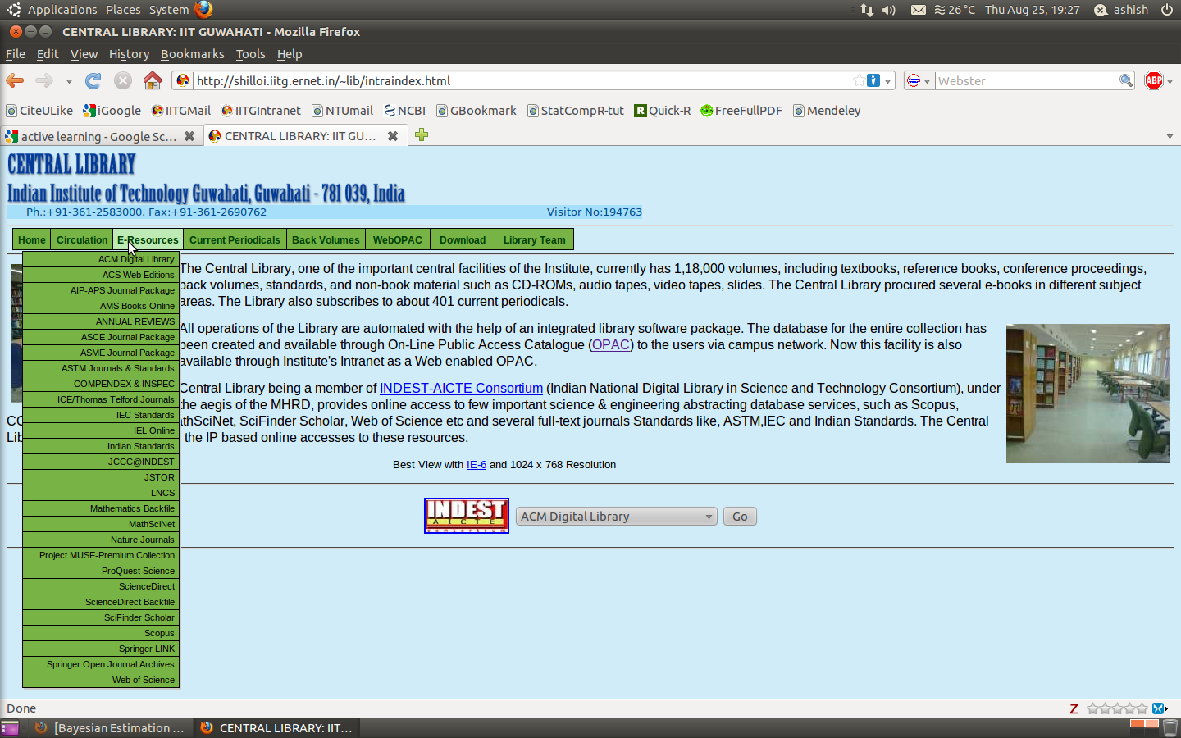
E-Resources at Central Library

Slide 14
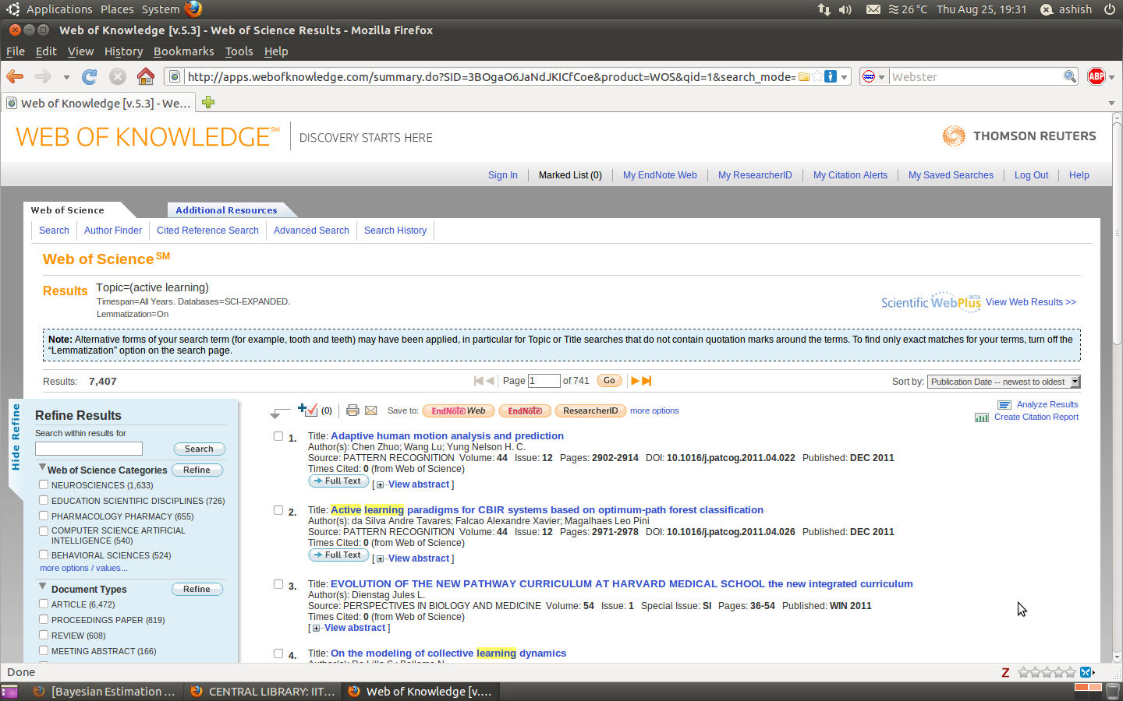
Web of Knowledge

Slide 15
Advantage of using Web of Knowledge
Refine results options
  Various options
  Can identify important groups working on similar topic, journals and conferences
Managing your searches and important papers
  Citation alert for Tracking citations
  My Saved Searches

Slide 16
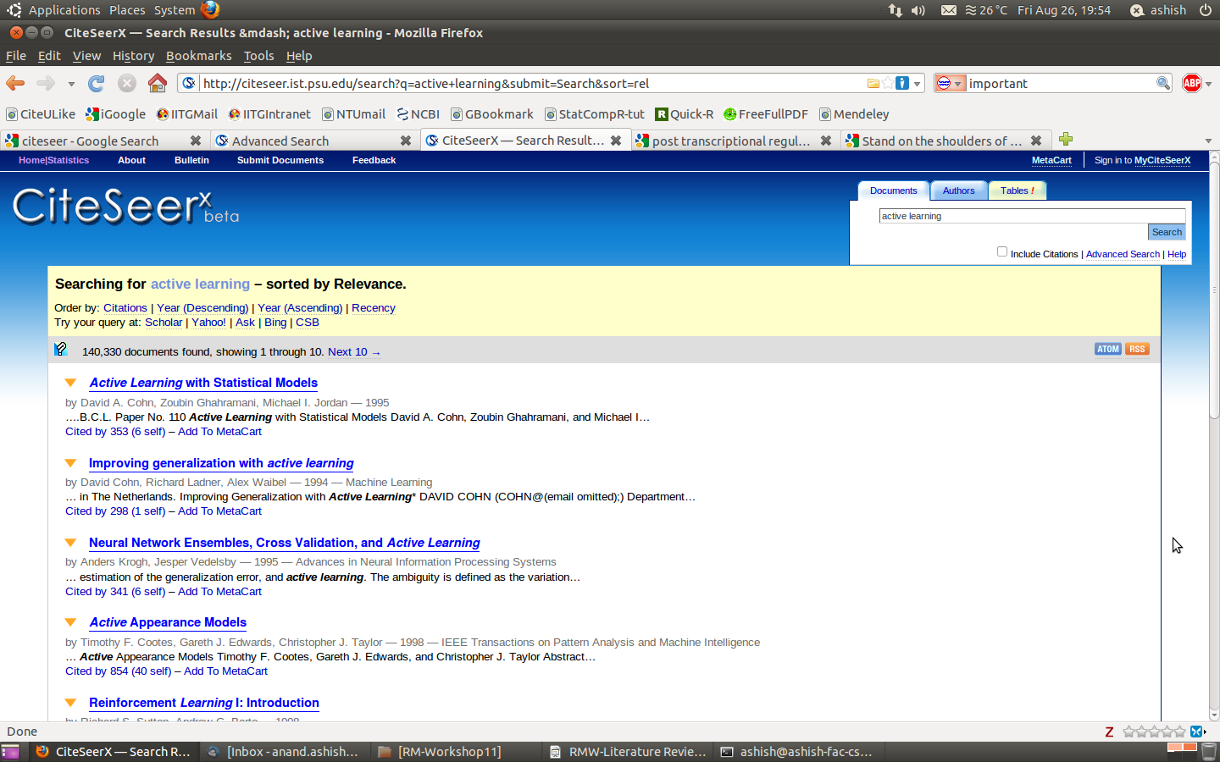
CiteSeer

Slide 17
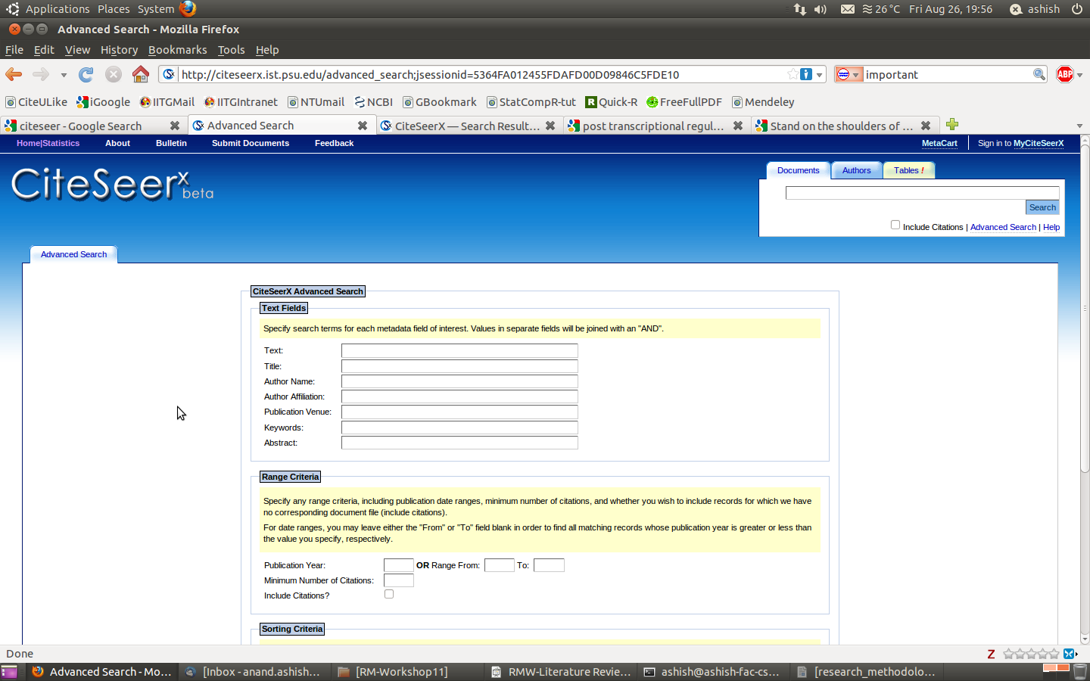
CiteSeer: Advanced Search Option

Slide 18
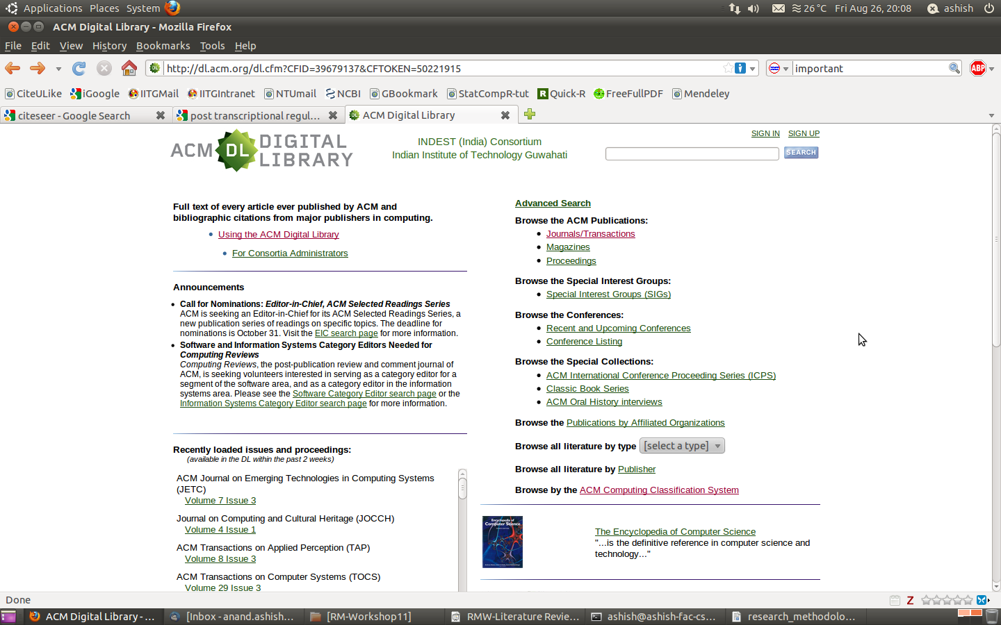
ACM Digital Library

Slide 19
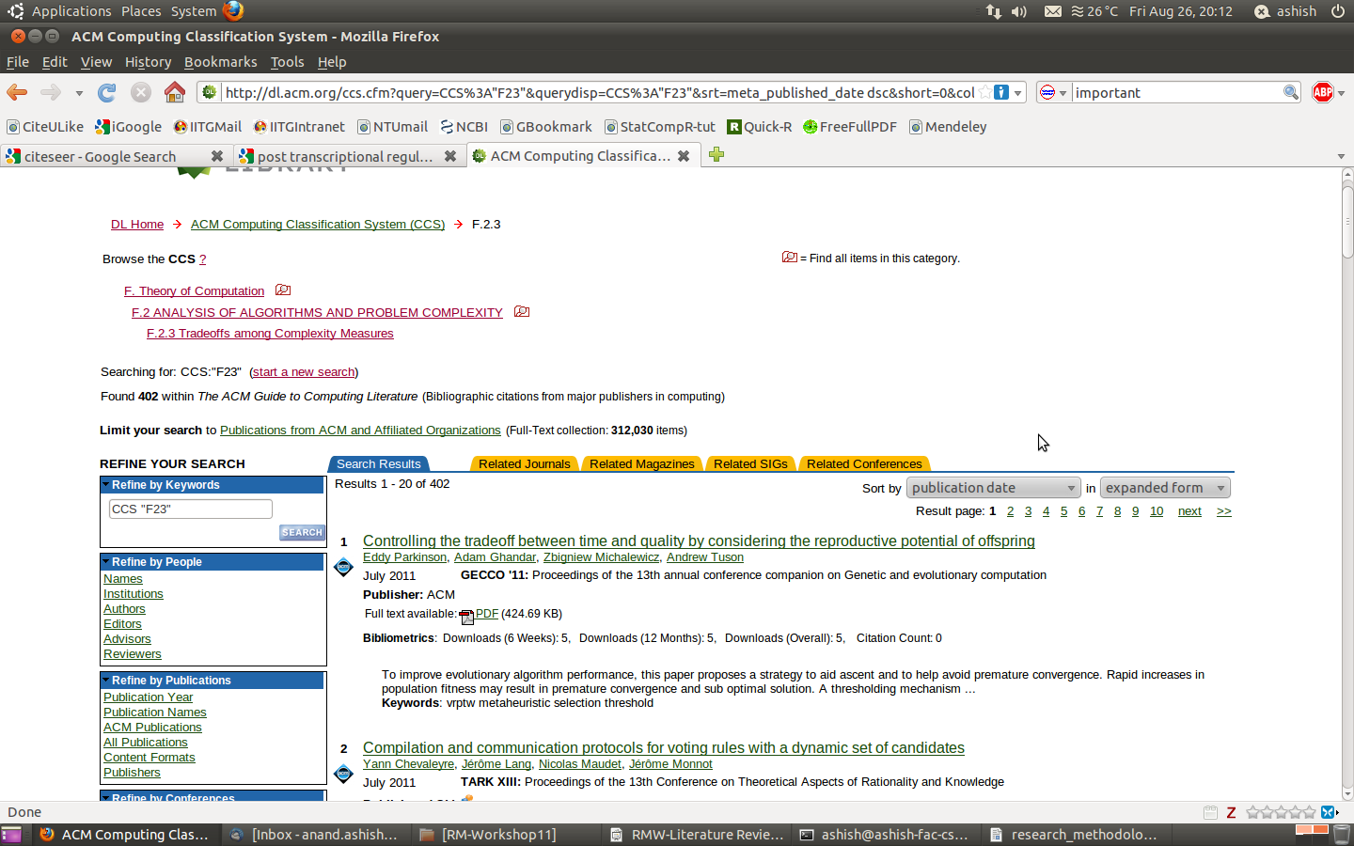
ACM Digital Library

Slide 20
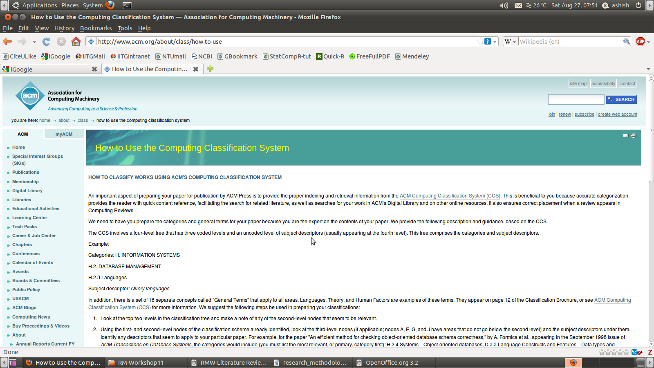
ACM Digital Library

Slide 21
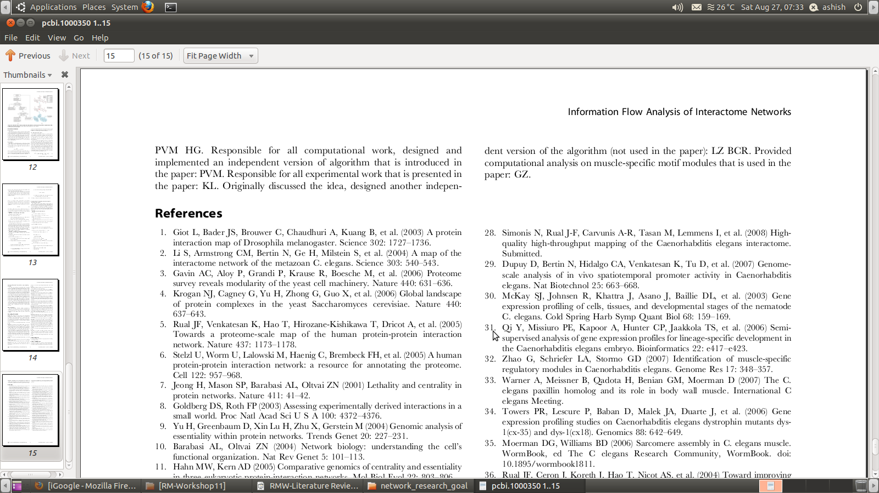
Not to forget

Slide 22
Assessing results
How many citations
  % of self-citation
  % of co-citation
Where it was published
  One of top conferences or journals
Peer-group reputation
  Only when attend conferences
  discussion with experts in related research area
Only a rough guide, not necessarily all of the criteria has to be satisfied .

Slide 23
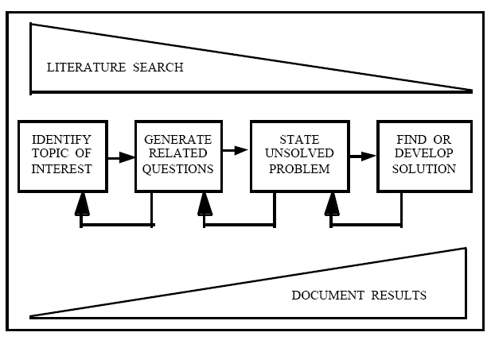
Source: Performing a literature review. Lois E Reed

Slide 24
Managing and Organizing Search Results
Mendeley
  Desktop-version
  Web-browser add-on
  Web-based
  Sharing and collaboration
Cite u like
  Recommend you papers also once you have saved few papers in your account
  Web-browser add-on
  Web-based
  Sharing and collaboration

Slide 25
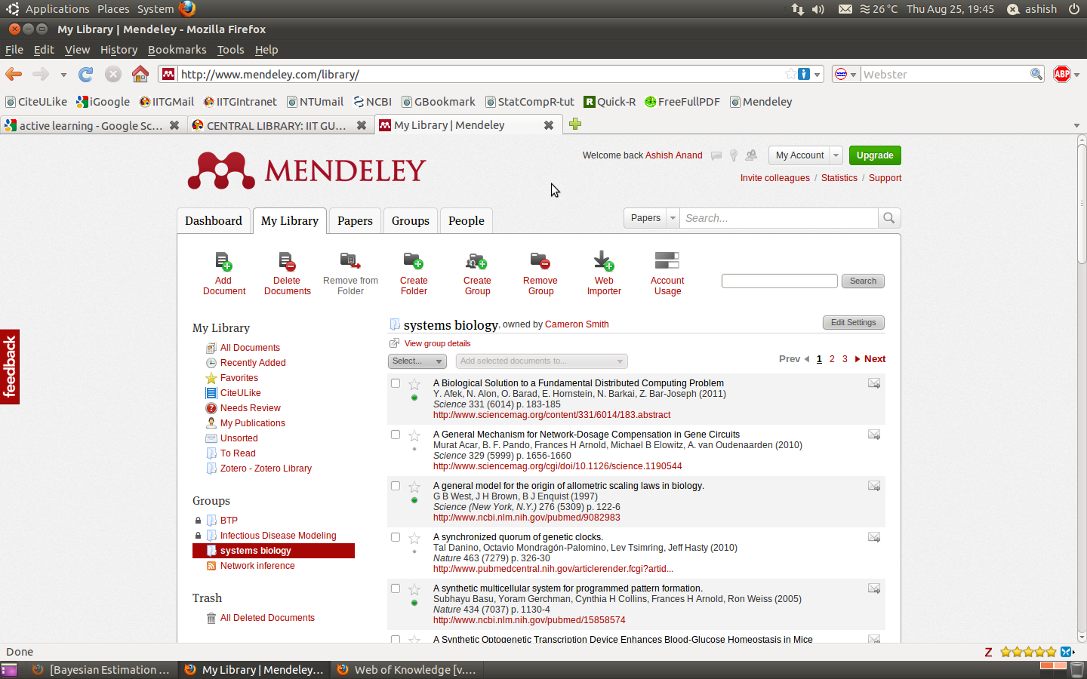
Mendeley

Slide 26
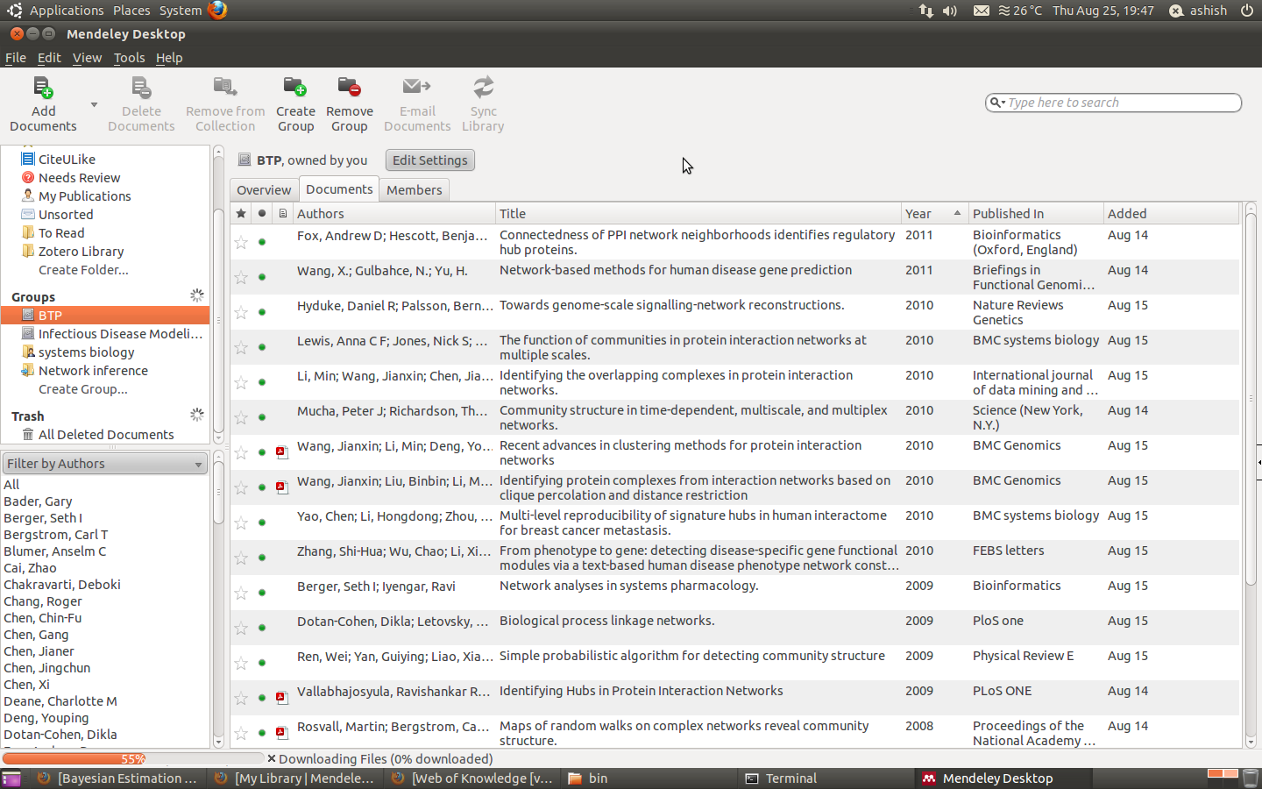
Mendeley

Slide 27
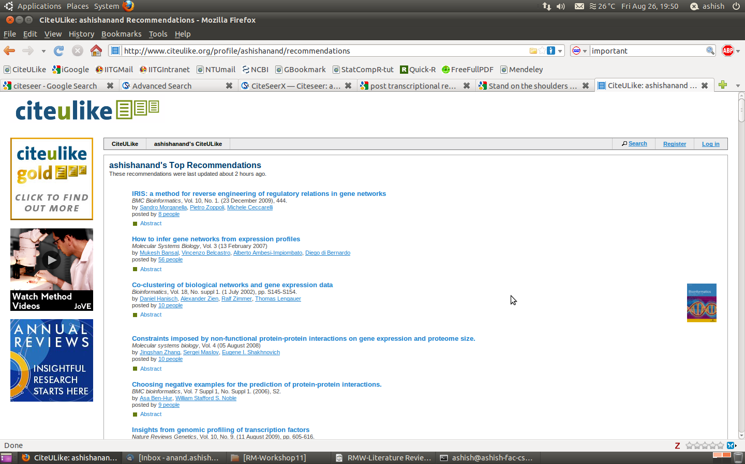
Cite U Like

Slide 28
Am I Done?
Time-Line
  Too-long vs too-short
  Continuous process?
Keeping track of relevant research
  Citation alerts
  TOC alerts from journals
  Keeping eye on recent conferences
  Keeping track of few leading research group

Slide 29
Thanks !
Questions and Comments

